Slide 1

WOLLO UNVERSITY(KIOT)
COLLEG OF INFORMATICS
DEPARTEMINT OF SOFTWARE ENGINEERING
SOFTWARE PRACTICE AND TOOL STUDENT VOTING SYSTEM PROJECT

Slide 2
GROUP MEMBER
NO NAME ID
1, Beyene Bishaw ………………..........................0967/10
2, Arebu Tadesse ………………………………………....0840/10
3, Abuker Sofiyan…………………………….…………….0743/10
4, muhammed Genzeb……………………………………0588/10 5, Yitbarek simur………………………………………………0630/10
6, Mudesir Maru ……………………………………...……1781/10

Slide 3
Chapter 1
Introduction
Overview
Voting is one of the fundamental duties of the community .
Election allows the people to choose their representatives and express their favorites for how they will be governed. Naturally, the integrity of the election process is fundamental to the integrity of democracy itself.
Election in the history of wollo University has been held for many times. But, still students are complaining on the announcement of the final results; because of the thought they have on fraudulent activities.
The election system must be sufficiently robust to resist a variety of fraudulent behaviors and must be sufficiently clear and understandable that voters and candidates can accept the results of an election.
To achieve all this, software technology is required.

Slide 4
Statement of the problem
Manual voting has caused some difficulties for voting process and also it has some disadvantages for the students.
The main problems of the system are:
Problem for election board to manage the records.
Problem for duty staff to search the record of a particular voter.
Problems in filling the forms.
Unauthorized vote casting.
Because the current system cannot enhance the data validation in a meaning full manner, voters often the incomplete and incorrect data.
A small mistake can cause of rejection of vote.
Time is very important factor for measuring the efficiency of the system. The current system requires a lot of time for data process circulation and calculation.

Slide 5
Objectives of the project
General Objective
The main objective of the project is to automate students’ representative voting system of Wollo University by replacing the current manual system.
Specific Objective
The specific objectives of the system are:
Study the existing system
Develop a new automated system
Make operation easy: The system should be easy to operate and should be such that it can be developed within a short period of time and fit in the limited budget of the user.
Increase Accuracy: The system functionality should ensure that no one can falsify or modify the result of the voting by eliminating a valid vote or counting an invalid vote in the final count.
Make convenience: The system should allow and assist voters to cast their votes quickly.
Scalable: The size of the election should not drastically affect performance.
Testing the developed system.

Slide 6
Chapter Two
Requirements and System Modeling
Functional Requirement
The functional requirements are functions or features that the system must include to satisfy the user need and to be acceptable by the user .
The functional requirements of the new system include : Data storage, count and retrieval: All the voters and candidates’ information should be kept properly in well organized database; so that counting vote and retrieving records from the database will be easy and faster.
The system should register voters and candidates.
The system should provide cast vote facility.
The system should be able to generate report including candidates’ and voters’ information, progress and final result.
The system should provide Searching, and deleting records mechanism (this is useful whenever the election needs to be held again).
The system should be flexible to get data of voters and candidates whenever required.
System do online vote polling.
Result compilation i.e. correct result will be generated.

Slide 7
Non-Functional Requirement
The non-functional requirement describes constrains for implementing the project . Some of them are; the central server has to be provided at secured area, the system must be maintainable and expandable, the network infrastructure has to be private network, client machines anywhere inside the campus could access the system. The voter and candidates should have also basic computer skills. The input value which is used to generate the encryption key must be provided from the election officials, and needs to be kept securely.
Non-Functional requirements of the system described as follow:
The software will be user friendly.
It will have the standard graphical user interface.
Security of data.

Slide 8
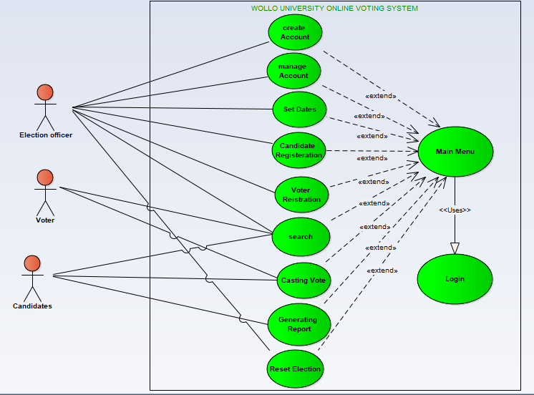
System Modeling
Use Case Diagram
A use case is an interaction between users and a system. It captures the goal of the users and the responsibility of the system to its users .

Slide 9
Actors of the system
Actors represent system users. An actor is someone or something that participates in the election process .
The system has three players: Election Committees (Election Officers), Voter, Candidate
Election Officer is the one who takes care of the overall commitments of the voting process.
Voter is a student who participates in the election by casting his/her vote.
Candidate is a student who participates in election by contesting in it.

Slide 10
Table 2.1 General Usecase Description
Name | Identifier | Description
Set Date | UC1 | Used to set the starting and ending date of both for registration and voting.
Manage Account 1. Create Account 2. Delete Account 3. Update Account | UC2 | Contain three sub use cases
 | UC2.1 | Enable users to create a user account
 | UC2.2 | Enables election officer to delete an account
 | UC2.3 | Enables users to update an account
Login | UC3 | Enable all user to login into the system
Candidate Registration | UC4 | Enable election officer to register election Candidates
Voter Registration | UC5 | Enable voters to register themselves
Search Voter Search 2. Candidate Search | UC6 | Contain two sub use cases
 | UC6.1 | Enables all users to search a particular voter
 | UC6.2 | Enables all users to search a particular Candidates

Slide 11
Count….
Name | Identifier | Description
Report | UC7 | Enables users to generate the aggregate voter report, aggregate candidate report, to generate counted result of the candidates and candidates’ progress.
Casting Vote | UC8 | Enable voters and candidates to give votes to alleged candidates

Slide 12
Sequence diagram
Sequence diagrams are used to model the logic of usage scenario . Usage scenario is exactly what its name indicates-the description of potential ways our system is used.
Sequence diagrams are a great way to validate and flesh out the logic of use case scenarios and to document the design of the system .
The project team has modeled sequential diagram for the major use cases identified in use case modeling part.

Slide 13
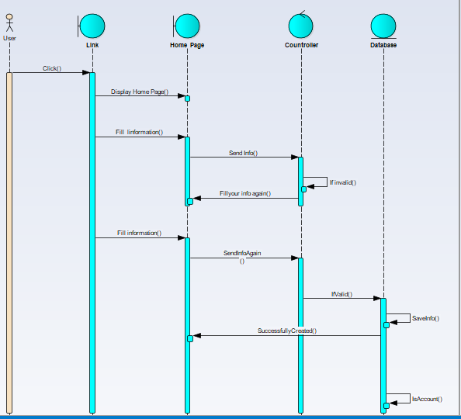
Sequence diagram for Create Account

Slide 14
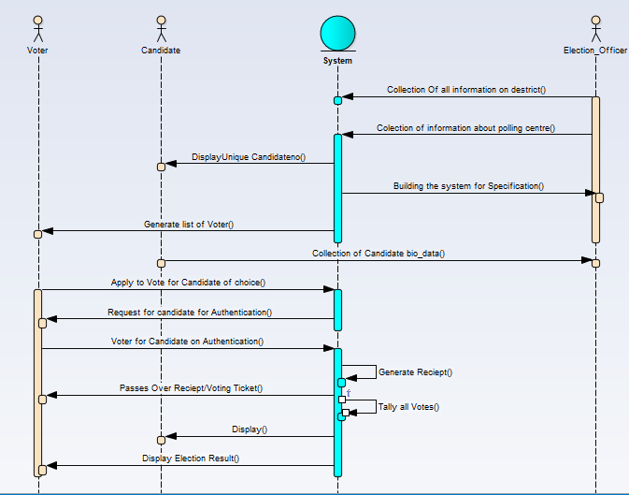
Sequence Diagram for Casting Vote

Slide 15
Activity Diagram
Activity diagram – is basically a flowchart to represent the flow from one activity to an other activity.The activity can be described as operation of the system .

Slide 16
Analysis level class diagram (Conceptual Modeling)
Another technique that is applied to support the conceptual analysis effort is the use of Class diagrams.
The UML Class Diagram is used to support both the analysis and the design phase.
Classes are an important aspect of object-oriented software .
When we recognize a pattern in which there a common group of things that have similar attributes and behaviors, we typically represent that as a class.
We are developing class diagrams by start at the “conceptual” level.
The team start by laying out the fundamental elements we think will be needed to support the objectives as identified in the Use Case diagrams.

Slide 17
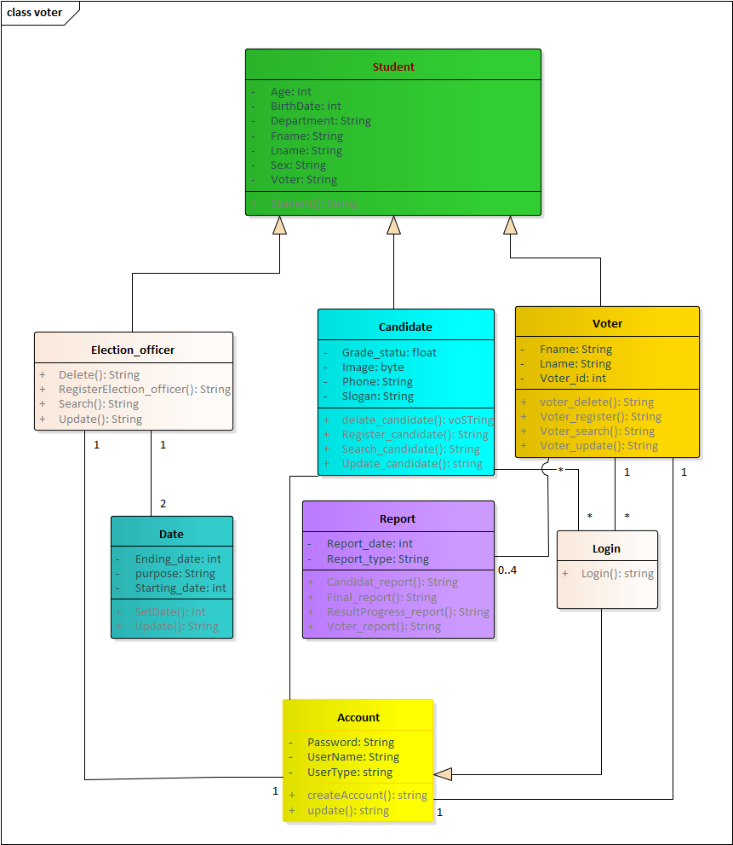
Conceptual Level Classes diagram

Slide 18
Description of the class
Account: - helps for creating a user account
Date: - helps during setting registration and voting time interval
Candidate: - helps during registering candidates to be elected
Voter: - helps during registering voters
Report: - helps during generating report of candidates, voters and results

Slide 19
Chapter three
Implementation of the system
In this phase the overall procedures, activities and methods of execution during the implementation phase of the project are included. This step takes much time when compared with other steps of the project competence. The source code or script of the project is included in the next part of the project.
Code generation main class
package Package1;
public class Students {
public int bach;
private String Department;
public String Fname;

Slide 20
count…
public String Lname;
public String Sex;
private String voter
public void finalize() throws Throwable {}
public String Students(){
return "";
} }//end Students
public void finalize() throws Throwable {}
public String Students(){ return "";}
}//end Students

Slide 21
Testing
Testing
Testing the final case of implementation. Testing is a proccess to show the correctness of the program. It is checking of the work ability in attempt to descover error and avoiding of such from the system.
Some example of testing is: -
Unit Testing: each model is tested individually to discover any errors in its code.
System Testing: _ this is the next level in the testing and tests the system as the whole.

Slide 22
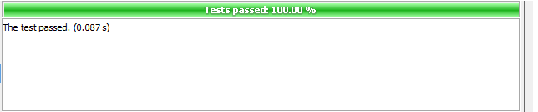
Sample of tasting main class
package student;
import org.junit.After;
import org.junit.Before;
import org.junit.Test;
import static org.jnit.Assert.*;
public class StudentIT {
Student s;
public StudentIT() { }
@Before
public void setUp() {
s=new Student(); }
@After
public void tearDown() {
s=null; } @Test
public void testSomeMethod() {
String a=s.Students();
assertEquals("beyene",a);
} }

Slide 23
software tool practice
Hardware requirement
For the successful run of the proposed system, the personal computer should have the following minimum hardware requirement:
hard Disk 500GB and 4 GB of RAM.
Flash 16 GB
Disctop
Pc(laptop)

Slide 24
count….
Software requirement
The minimum software requirements are
java
GitHub
Enterprise Architecture .
Microsoft word 20013, and PDF Writer: are used for reporting and preparing the documentation.
Snipping Tool
Microsoft power point 20013 modeling tool: is used for drawing all the UML diagrams.

Slide 25

The END !!! Questions

